Slide 1

Geographical Statistics of Engineering Internships
CYLIA BERKANE
FAGNUO CAI
GUSTAVO FLEURY
INDURAJ PR
QUOC VIET PHAM
YEN CHU CHEN
April / 2019
Notes:
As próximas visitas serão compostas por 2 consultores;

Slide 2
AGENDA
1
3
Next Steps/Conclusion
2
The Project
Technical Solution
Management Solution
4

Slide 3
The Project – User Requirements

Slide 4
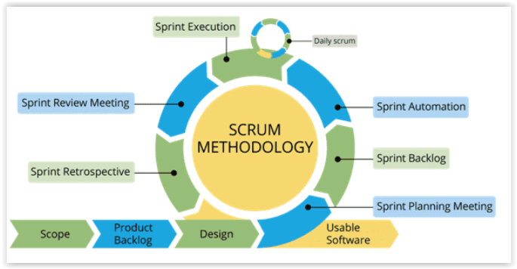
Management Solution

Slide 5
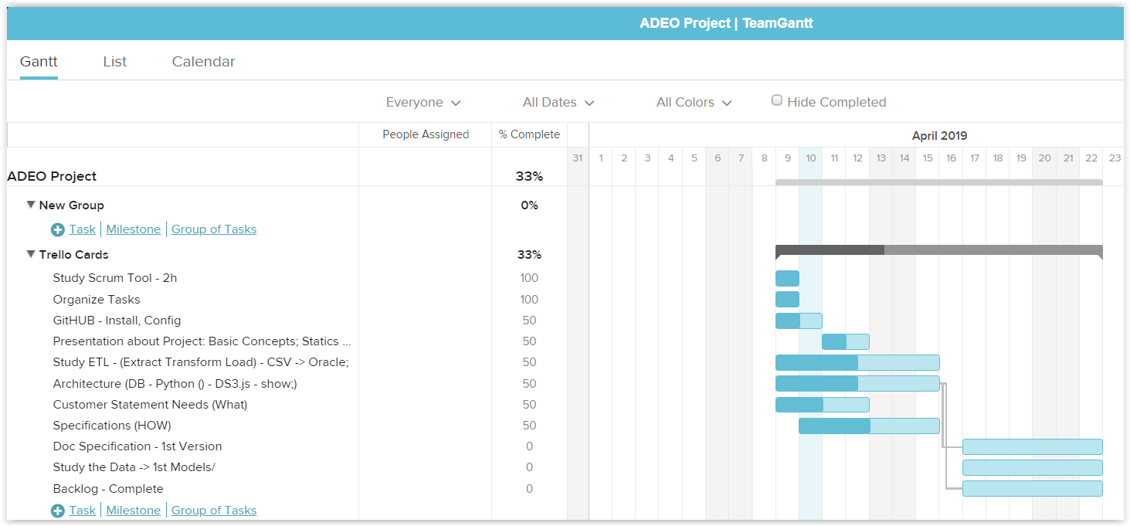
Management Solution - TeamGantt
XXXXX – UPDATE TEAM GANTT and the FIGURE;

Slide 6
Team Tasks Division
Infrastructure
Data Analysis
Visualization / Documentation
MANAGEMENT
XXXX: Put figures

Slide 7
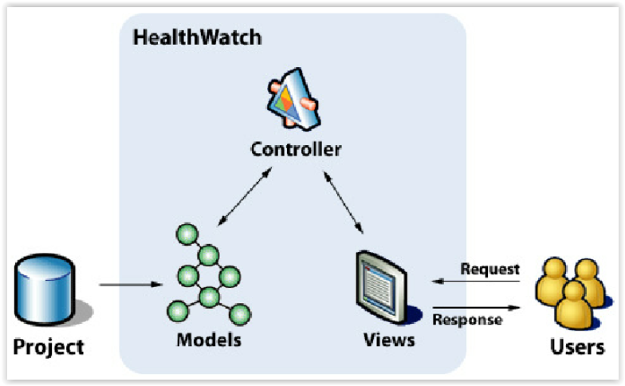
Technical Solutions - MVC

Slide 8

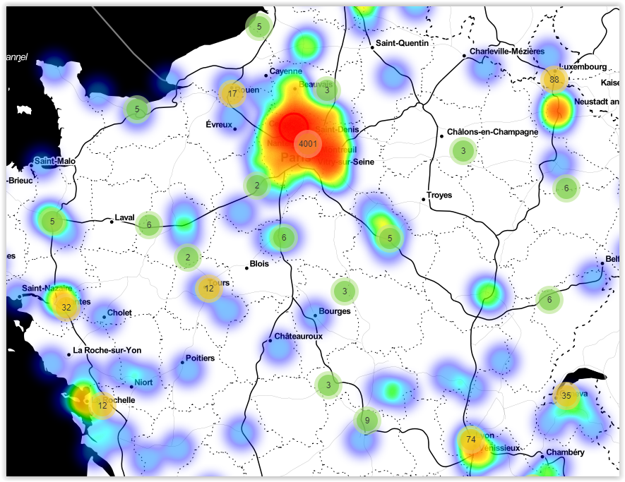





Technical Solutions – FINAL
Chart.js
Folium
Framework
Python
Anaconda
ETL
Database

Slide 9
The System
XXXX Slides for MAIN Funcionalites:
Login;
Insert Data;
ETL
....

Slide 10
Future Possibilities
XXXXX

Slide 11
Conclusions
XXXXX

Slide 12
Thank you!
Questions?

